Slide 1
Section 4.6
The Derivative in Graphing and Applications: “Rectilinear Motion”

Slide 2
All graphics are attributed to:
Calculus,10/E by Howard Anton, Irl Bivens, and Stephen Davis Copyright © 2009 by John Wiley & Sons, Inc. All rights reserved.

Slide 3
Introduction
Recall from section 2.1 that a particle that can move in either direction along a coordinate line is said to be in rectilinear motion.
The line might be an x-axis, y-axis, or an axis inclined at some angle, therefore, we will call it a general “s-axis”.

Slide 4
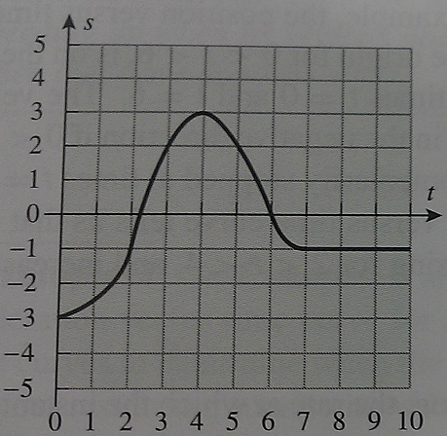
Example
Often when discussing rectilinear motion, we will convert from a position vs. time curve (above right) to just a position graph with the times labeled (below) to help us determine more information.
On the position vs. time curve, the leftmost point is (0,-3) which is where we got the first point on the other graph: at time zero, the position is -3.
On the position vs. time curve, the absolute maximum is (4,3) which is where we got the second point on the other graph: at time 4, the position is 3.
After time 7, the particle stays in the same position at -1.

Slide 5
Velocity and Speed
As we have already discussed, instantaneous velocity is the derivative of the position function:
v(t) = s’ (t) = ds/dt
The sign of the velocity tells which way the particle is moving.
+v(t) means that the position is increasing with time
-v(t) means that the position is decreasing with time
v(t) = 0 means that the particle has momentarily stopped
Please remember that there is a difference between velocity and speed: velocity has a direction and speed does not.
Therefore, speed = $\left|velocity\right|$

Slide 6
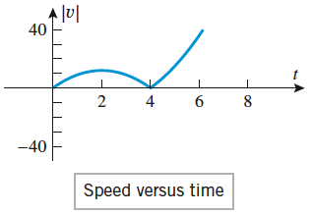
Example
Let s(t) = t ³ – 6t ² be the position function of a particle moving along an s-axis, where s is in meters and t is in seconds. Find the velocity and speed functions, and show the graphs of position, velocity, and speed versus time.
v(t) = s ‘ (t) = 3t ² -12t
Remember: speed = $\left|velocity\right|$

Slide 7
Acceleration
As we have also already discussed, the rate at which instantaneous velocity of a particle changes with time is called its instantaneous acceleration which is the derivative of velocity:
a(t) = v’ (t) = dv/dt OR a(t) = s’’ (t) = d²s/dt²

Slide 8
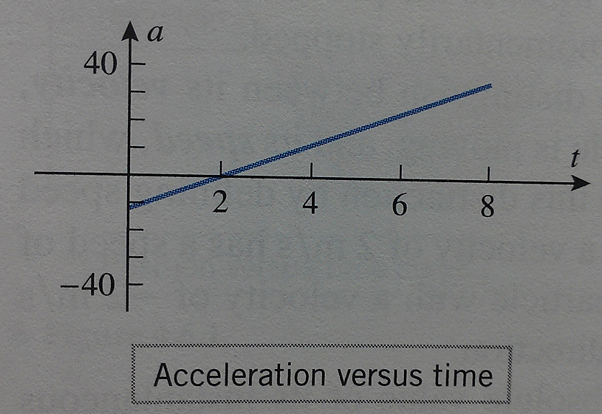
Example Continued with Acceleration
Using the same position function from the previous example: s(t) = t ³ – 6t ² , find the acceleration function a(t), and show the graph of acceleration versus time.
We found velocity = v(t) = s ‘ (t) = 3t ² -12t
Acceleration = a(t) = v ‘ (t) = s” (t)
= 6t – 12

Slide 9
Speeding Up and Slowing Down
We will say that a particle in rectilinear motion is speeding up when its speed is increasing and slowing down when its speed is decreasing (which sounds obvious).
The fact that speed = $\left|velocity\right|$ makes this determination a little more challenging due to the absolute value.

Slide 10
Speeding Up and Slowing Down con’t
A particle with negative velocity is speeding up when its acceleration is negative (it is getting “more negative, faster”).
Likewise, a particle with negative velocity is slowing down when its acceleration is positive.
I find it easiest to make a number line and label where the velocity and acceleration are positive, negative, and zero (see next few slides).

Slide 11
Example
Suppose that the position function of a particle moving on a coordinate line is given by
s(t) = 2t ³ – 21t ² + 60t + 3.
Analyze the motion of the particle for time [0,3].
Solution:
v(t) = s ‘ (t) = 6t² - 42t + 60 = 6(t-2)(t-5)
a(t) = v ‘ (t) = s “ (t) = 12t – 42 = 12(t-(7/2))
Set both v(t) and a(t) = 0 and solve for t to start your number line.
Put zeroes accordingly on each number line to represent those solutions.
Next, test intervals and put +/- along line.

Slide 12
***Sign Analysis of Velocity and Acceleration Functions***
The velocity function is moving in the positive direction for time [0,2), stops momentarily at time t=2, moves in the negative direction for time (2,5), stops momentarily at time t=5, and then moves in the positive direction thereafter.
Analyze acceleration using a similar procedure.
Where the signs are the same, the particle is speeding up and where the signs are different, the particle is slowing down.

Slide 13
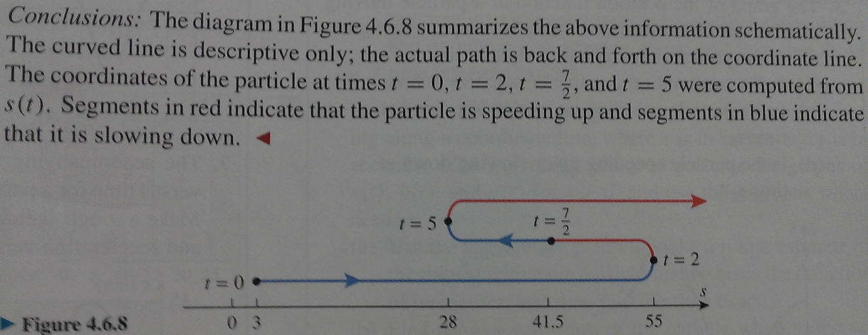
You need to be able to draw schematic representations like this for these problems.

Slide 14
Summary of Motion Analysis

Slide 15
Disneyland with Nephews

